Slide 1
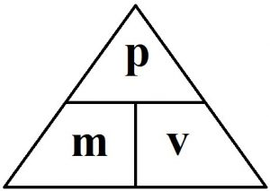
5A Further mechanics Momentum
Momentum is a measure of the amount of motion an object has, and it is the product of an object's mass and its velocity.
$$p=m x v$$
momentum
mass
velocity
Notes:
The amount of motion an object has, not to be confused with inertia which is the resistance of an object to the change in its movement.
Momentum is a vector quantity, it is measured in kg*m/s

Slide 2
Momentum
Newton’s 2nd law of motion: The rate of change in momentum of a body is directly proportional to the resultant force applied to the body. And is in the same direction as the force. $F=m × a$ F = m $×$ $\frac{∆v}{∆t}$
$F= \frac{∆p}{∆t}$ = $\frac{final momentum −initial momentum}{∆time (s)}$
Notes:
Newton’s 2nd Law aka conservation of momentum
A = /\V / /\t
Force is the change of momentum over time,

Slide 3
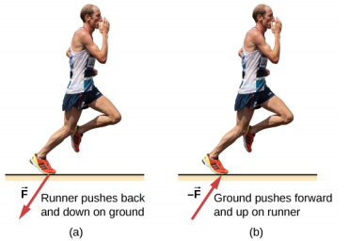
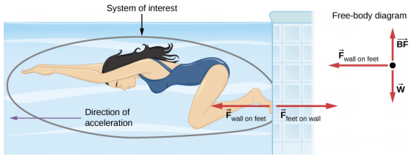
Momentum
Newton’s 3rd law of motion: For every action, there is an equal and opposite reaction.
$F=m × a$ F = m $×$ $\frac{∆v}{∆t}$
$F= \frac{∆p}{∆t}$ = $\frac{final momentum −initial momentum}{∆time (s)}$ = = $\frac{mv −mu}{time (s)}$
Notes:
Newton’s 2nd Law aka conservation of momentum
A = /\V / /\t
Force is the change of momentum over time,
An action reaction-pair is formed when act and react are the same type of force,
Momentum = force x time

Slide 4
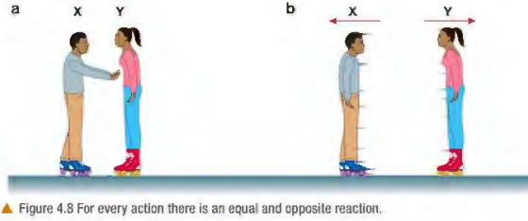
Momentum
Newton’s 3rd law of motion: For every action, there is an equal and opposite reaction.
$F=m × a$ F = m $×$ $\frac{∆v}{∆t}$
$F= \frac{∆p}{∆t}$ = $\frac{final momentum −initial momentum}{∆time (s)}$ = = $\frac{mv −mu}{time (s)}$
Notes:
Newton’s 2nd Law aka conservation of momentum
A = /\V / /\t
Force is the change of momentum over time,
An action reaction-pair is formed when act and react are the same type of force,
Momentum = force x time

Slide 5
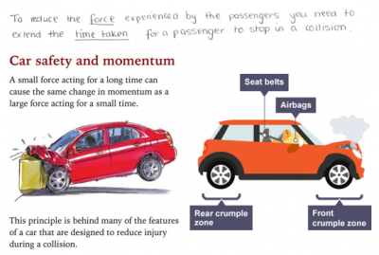
Momentum
Newton’s 3rd law of motion: For every action, there is an equal and opposite reaction.
$F= \frac{∆p}{∆t}$ = $\frac{final momentum −initial momentum}{∆time (s)}$ = = $\frac{mv −mu}{time (s)}$
Notes:
Newton’s 2nd Law aka conservation of momentum
A = /\V / /\t
Force is the change of momentum over time,
An action reaction-pair is formed when act and react are the same type of force,

Slide 6
Momentum
Solving for momentum: sum of momentum of system before = sum of momentum of system after
($m_{1}^{} × v_{1}^{}+m_{2}^{} × v_{2}^{} m_{1}^{} × v_{1}^{}+m_{2}^{} × v_{2}^{}$)
Before after
Notes:
See book bumper cars page 4
See book. Sometimes we can

Slide 7
Collisions: Law of conservation of momentum
Momentum
Total momentum before interaction = Total momentum after interaction
(the sum of the moments before interaction = the sum of the moments after interaction )
Solving momentum problems: Momentum before = momentum after p = m x v p = m x v
Notes:
In explosions, the starting momentum is 0 because at rest

Slide 8
Momentum

Slide 9
Momentum in 2D
For 2D collisions, we assume momentum before = momentum after, Example: a 0.17 kg cue ball travelling at 0.8 m/s strikes the 8-ball which has a mass of 0.19kg, calculate the speed of the 8-ball
8
8
https://phet.colorado.edu/en/simulations/collision-lab
Notes:
Use a table
C | 8 b4 0.136 0
Aftr 0.085 0.051

Slide 10
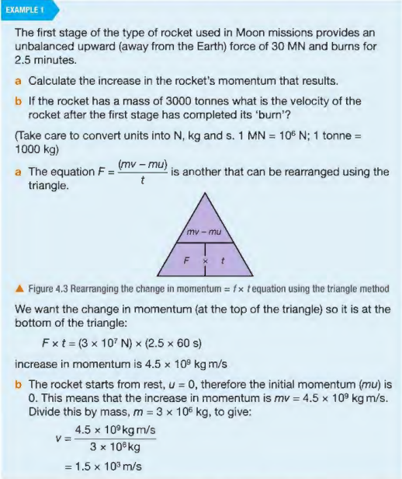
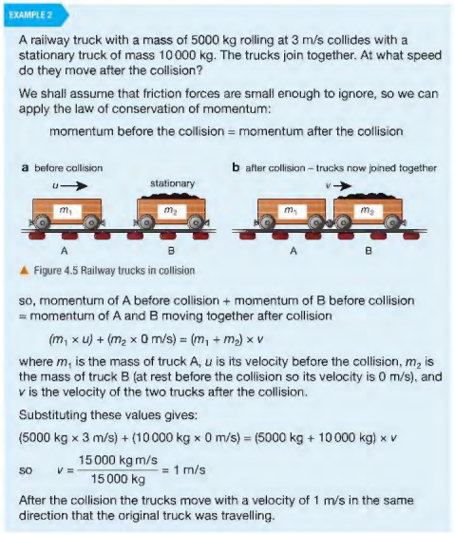
Momentum in 2D
https://phet.colorado.edu/en/simulations/collision-lab
Notes:
Use a table
C | 8 b4 0.136 0
Aftr 0.085 0.051

Slide 11
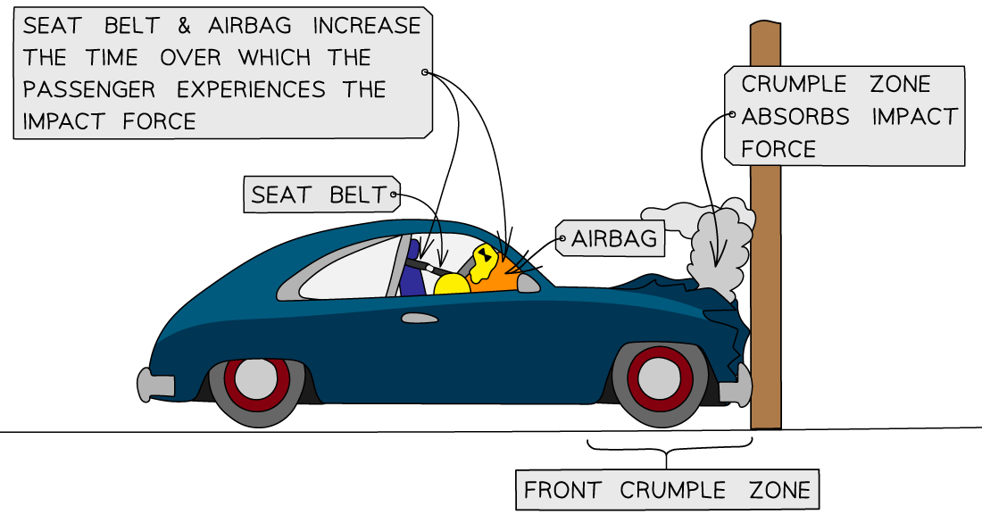
Car safety and momentum
Momentum in 2D
https://phet.colorado.edu/en/simulations/collision-lab
Notes:
F = deltaP/t

Slide 12
Car safety and momentum
Momentum in 2D
Cars are designed to have crumple zones to increase the time at which the momentum changes
Airbags act as a soft cushion to prevent injury on the passenger when they are thrown forward upon impact
Seatbelts are designed to stretch slightly to increase the time for the passenger’s momentum to reach zero and reduce the force on them in a collision
Notes:
F = deltaP/t

Slide 13
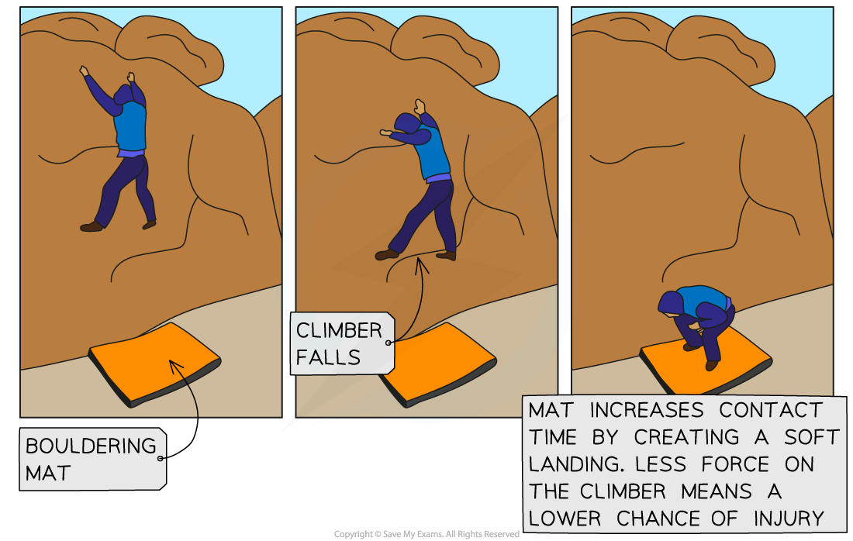
safety and momentum
Momentum in 2D
Notes:
F = deltaP/t
Child gymnasium has crash mats
Child playground have soft floor
All work by increasing contact (momentum change) time

Slide 14
HW

Slide 15
HW

Slide 16
Momentum
Energy transfer in collisions:
Elastic collisions: The total kinetic energy (and total momentum) of the system is the same before and after the collision. No energy loss is allowed
Inelastic collisions: The total kinetic energy of the system is not the same before and after the collision (even if the momentum of the system might be conserved).
FYI: elastic collision must be perfectly silent!
Notes:
Types of inelastic:
When two objects merge it is a perfectly inelastic collision.
When two objects collide but the 2nd object doesn’t stick (its just elastic)
Q: when a rubber ball bounces against an object, it is just inelastic
For perfectly elastic: no sound, no thermal loss, no bending (happens in atomic and subatomic particles)

Slide 17
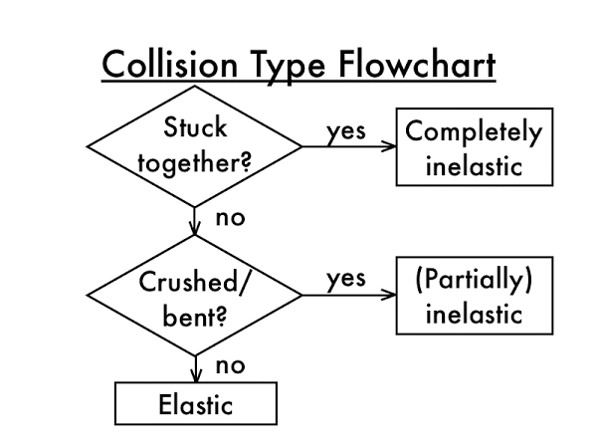
Momentum
Notes:
Have a look at this and appreciate it.

Slide 18
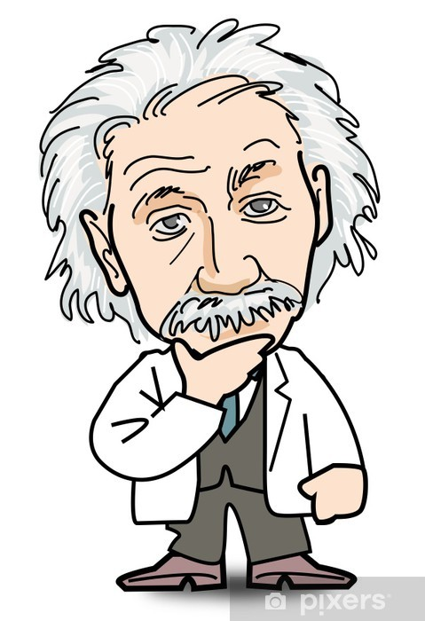
Momentum
In INELASTIC collisions, How can it be that momentum of a system is conserved but not kinetic energy ?
KE = $\frac{1}{2}mv²$ P = m x v
If we imagine two 1kg balls, one moving at 5 m/s and the other at rest. They collide inelastically and stick together, forming a single object.
Momentum before momentum after
P = m x v
5 kg m/s² = V_{f} x 2 kg
V_{f} = 2.5 m/s
Kinetic Energy before:
KE = $\frac{1}{2}$ 1 x 5² = 12.5 J
P = m x v
P = 2 x 2.5
P = 5 kg m/s
Kinetic Energy after:
KE = $\frac{1}{2}$ 2 x (2.5)² = 6.25 J
Notes:
Imp: to findout whether a collision is elastic, find total KE before collision, then total KE after collision. If same, then it’s good.
So momentum before and after is conserved, but the KE is not the same ? Let’s see an example.

Slide 19
Momentum
https://www.youtube.com/watch?v=Qco-M6BajjA
Notes:
So momentum before and after is conserved, but the KE is not the same ? Let’s see an example.

Slide 20
Momentum
Solving for momentum: sum of momentum of system before = sum of momentum of system after
($m_{1}^{} × v_{1}^{}+m_{2}^{} × v_{2}^{} m_{1}^{} × v_{1}^{}+m_{2}^{} × v_{2}^{}$)
Before after
Notes:
See book bumper cars page 4
See book. Sometimes we can

